Slide 1
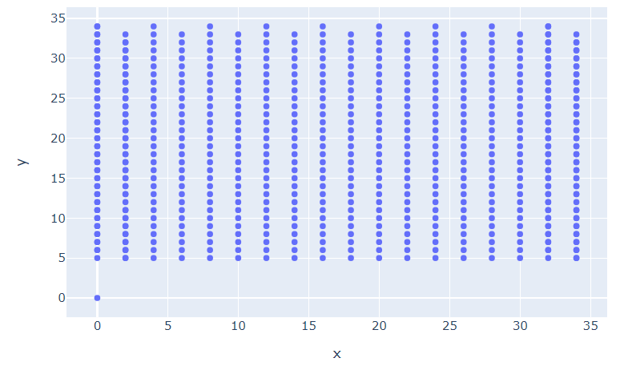
Hall1
Hall2
Hall3
Hall4
Hall5
Hall6
Hall7
Hall8
Hall9
A1
A2 A3
A4 A5
A6 A7
A8 A9
A10 A11
A12 A13
A14 A15
A16 A17
A18
Depot

Slide 2

Throughput
Time in Full

Slide 3
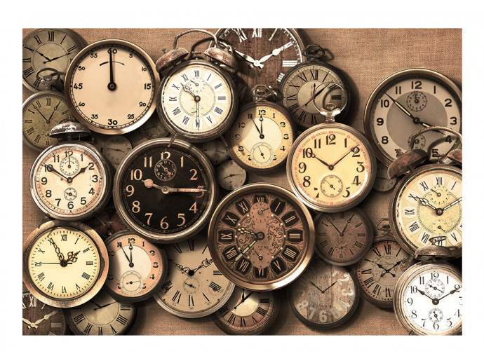
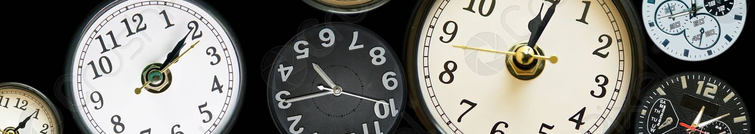

Slide 4
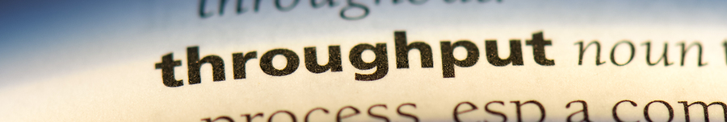

Slide 5






Throughput = 5/40
Orders = 5
Time = 40s
Distance = 40m
Throughput = 5/25
Orders = 5
Time = 25 sec
Distance = 25m

Slide 6
Throughput = 3/60
Orders = 3
Time = 60s
Distance = 60m
Velocity = 1m/s
Throughput = 3/45
Orders = 3
Time = 45 sec
Distance = 45m
Velocity = 1m/s

Slide 7
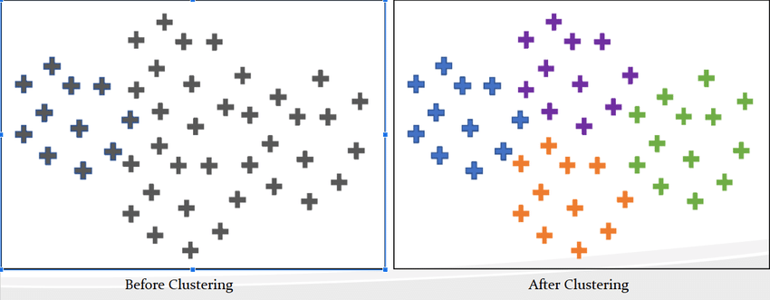
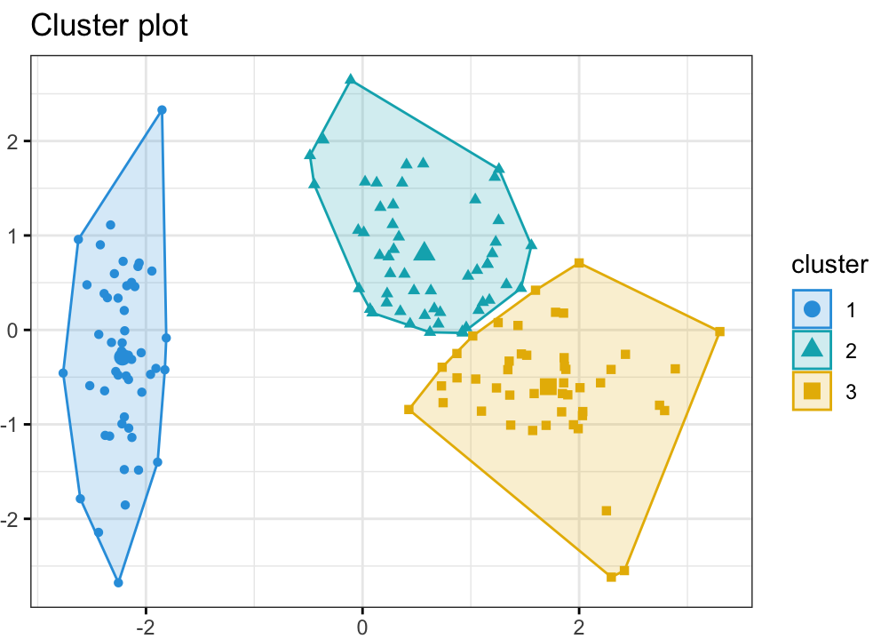
Clustering

Slide 8


Slide 9
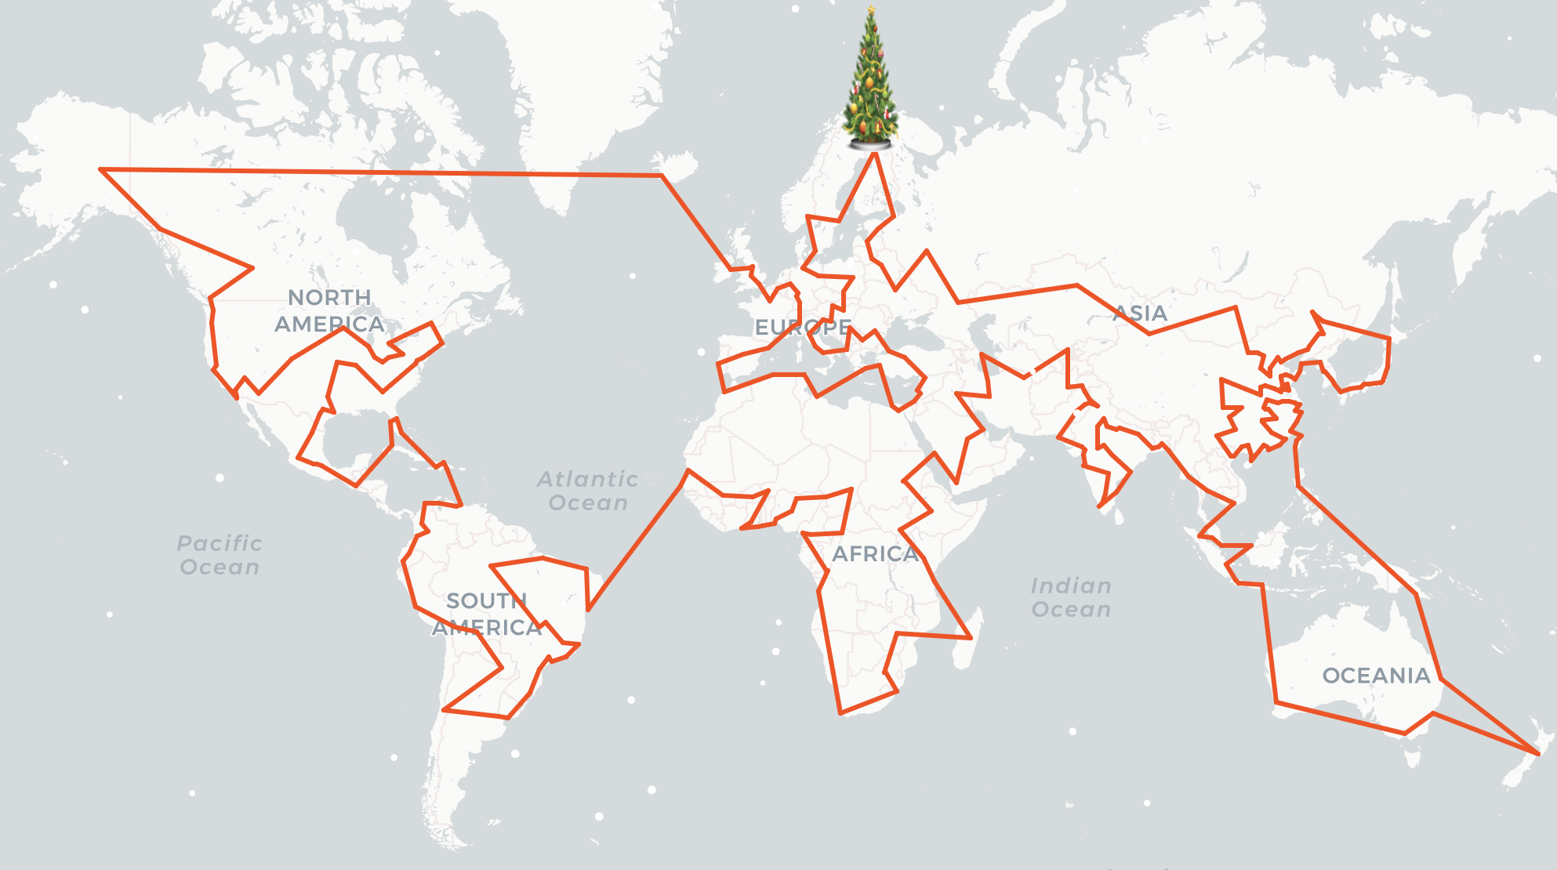
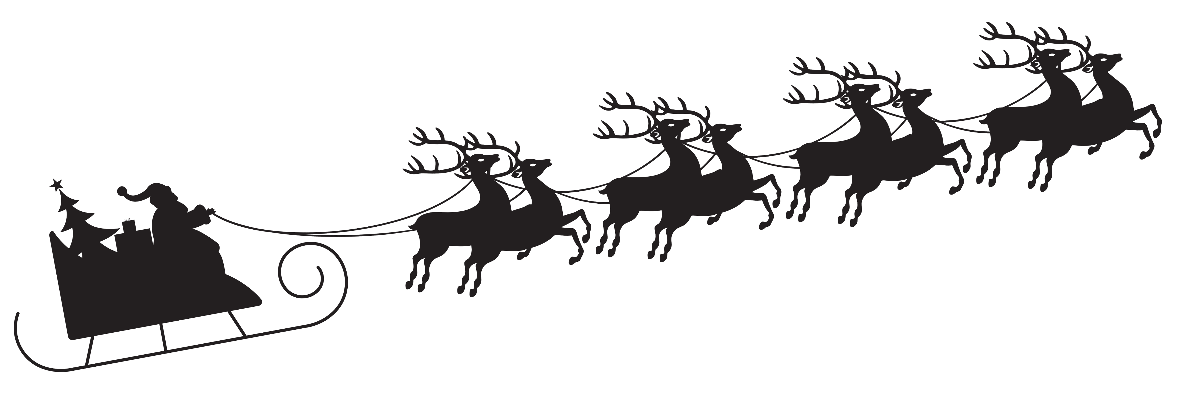

Slide 10
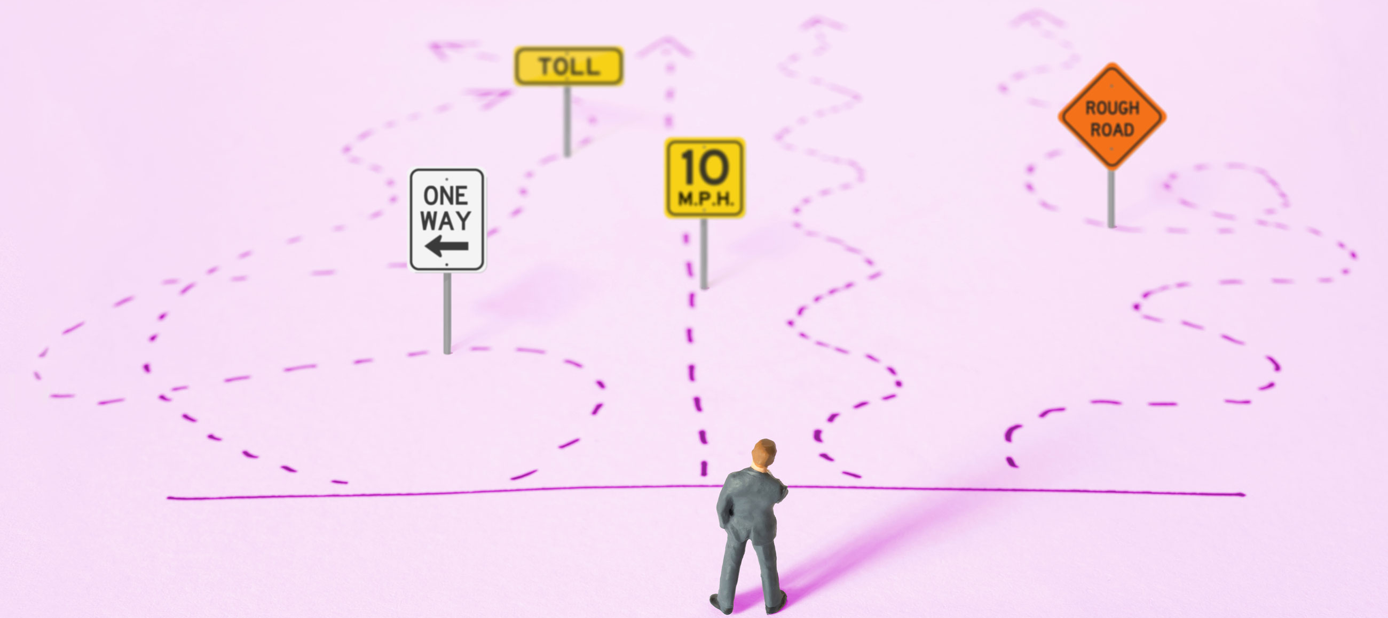

Slide 11


Slide 12
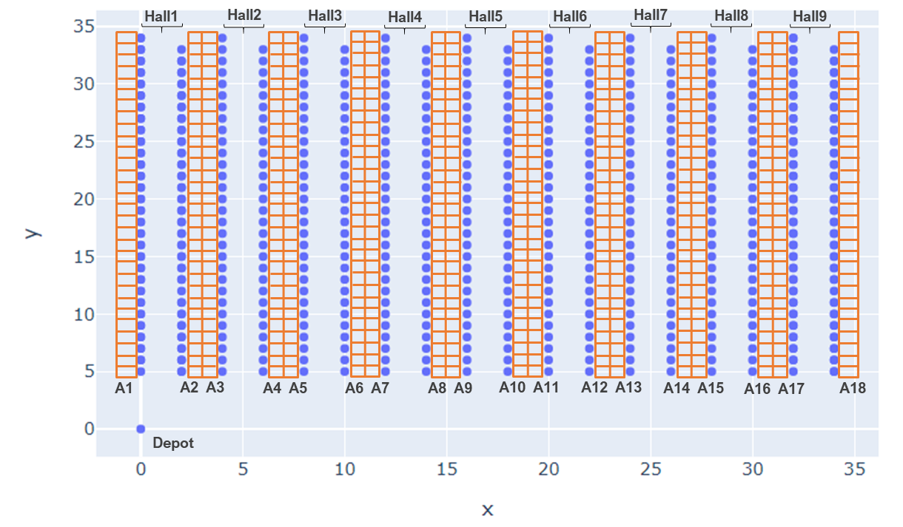

Slide 13
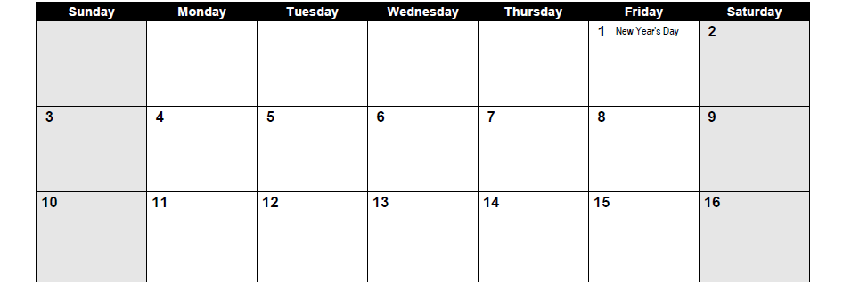
Today
8 orders
10 orders
2 orders

Slide 14
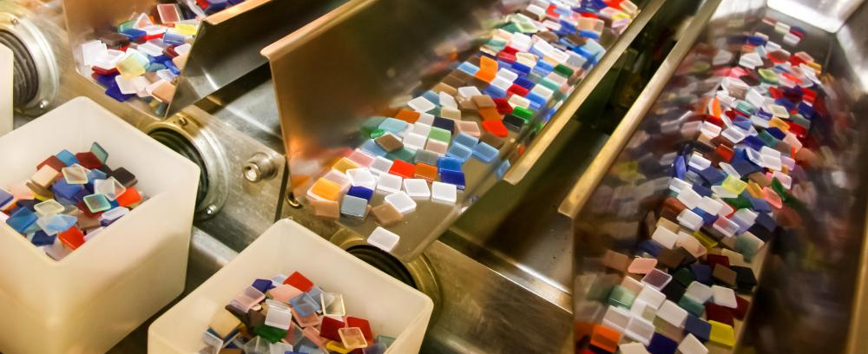

Slide 15


Slide 16
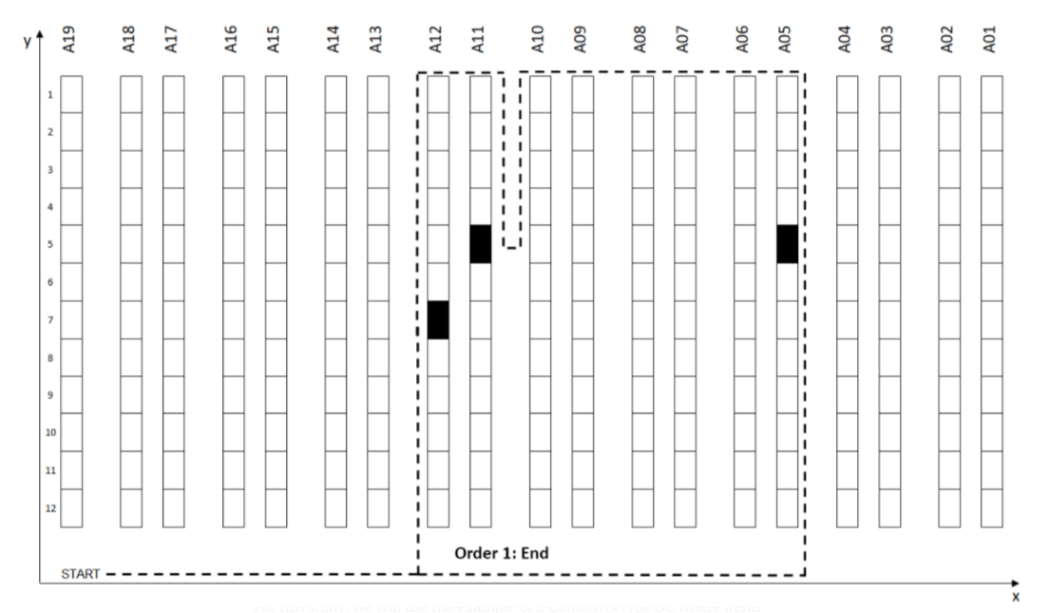
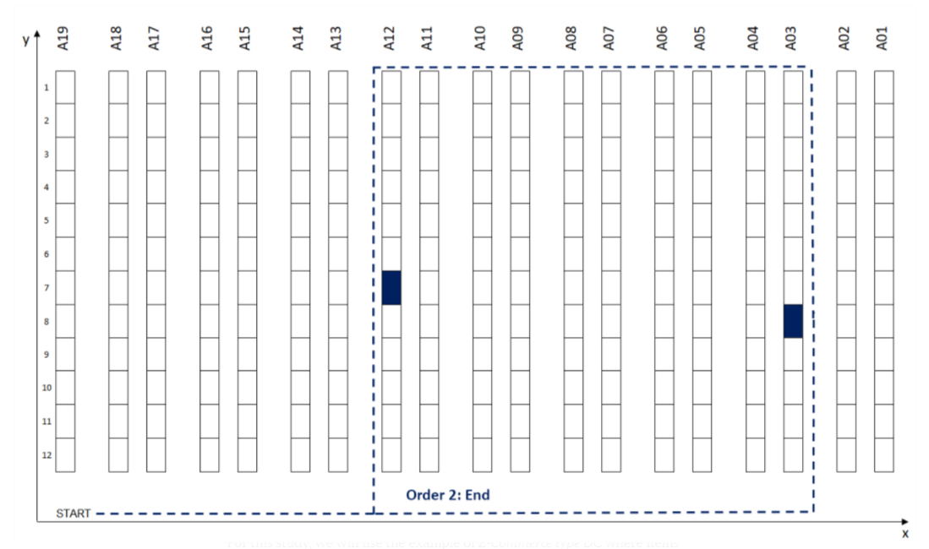
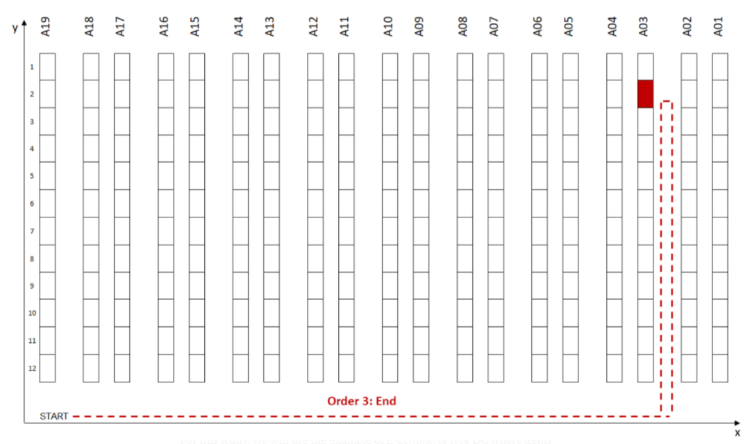

Slide 17
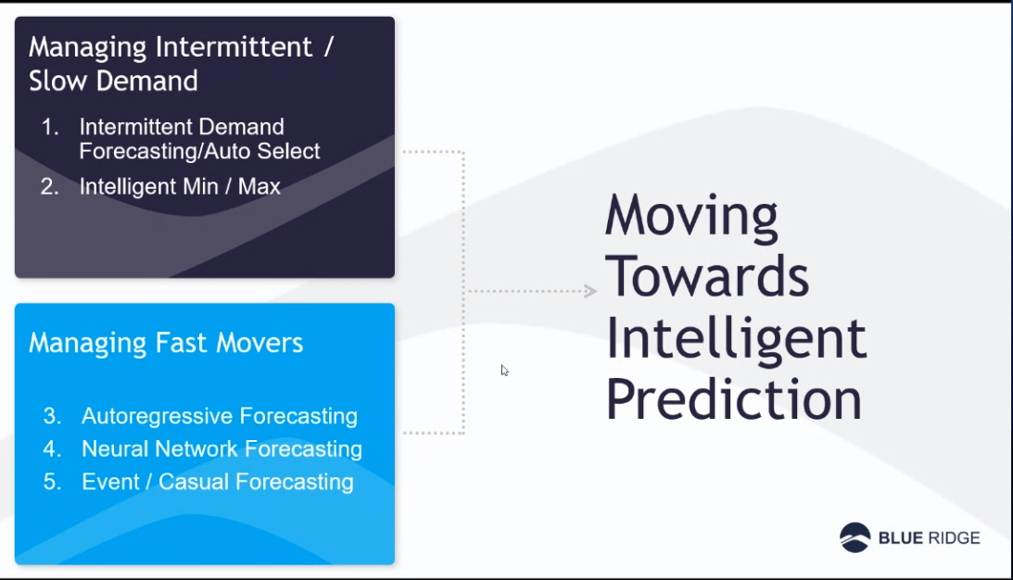
Intelligent prediction

Slide 18
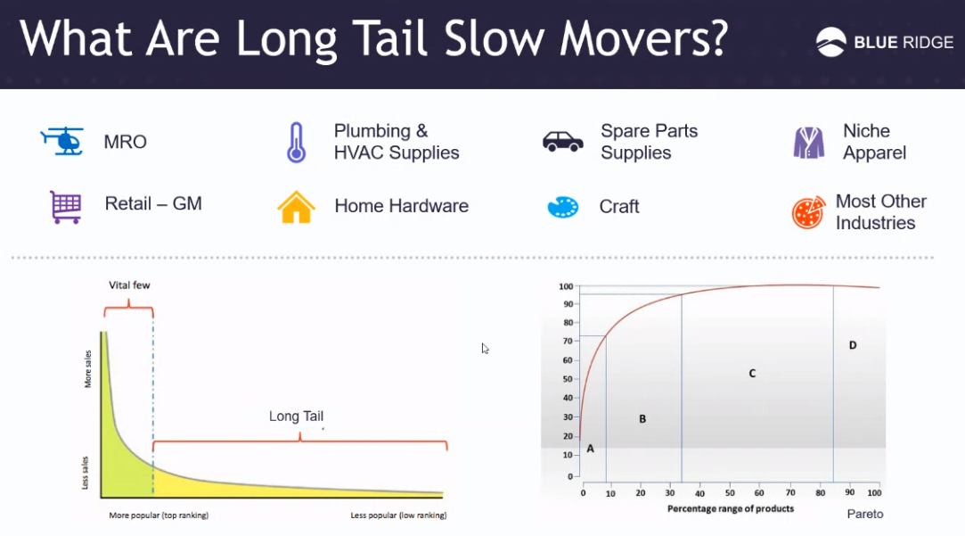
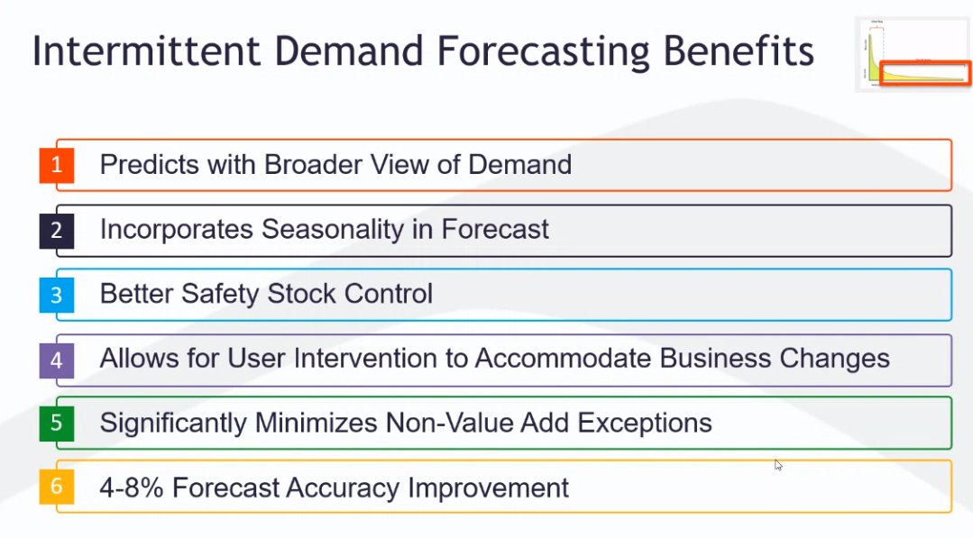

Slide 19
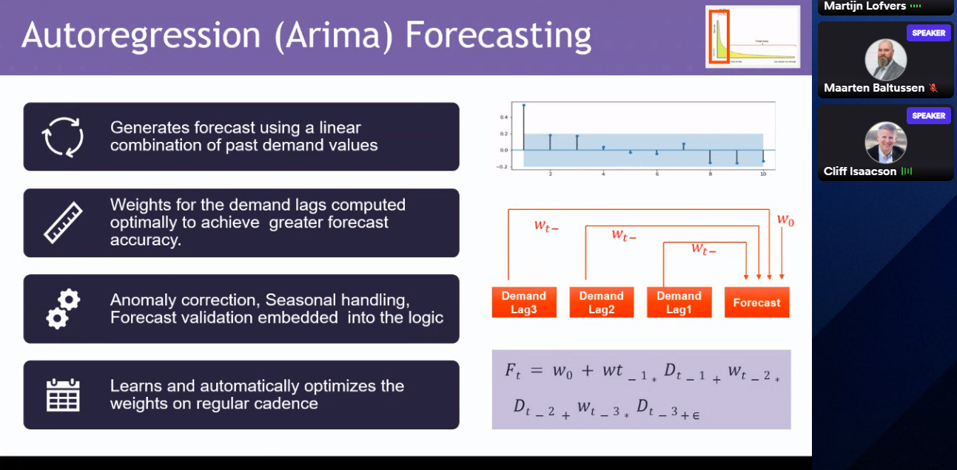

Slide 20
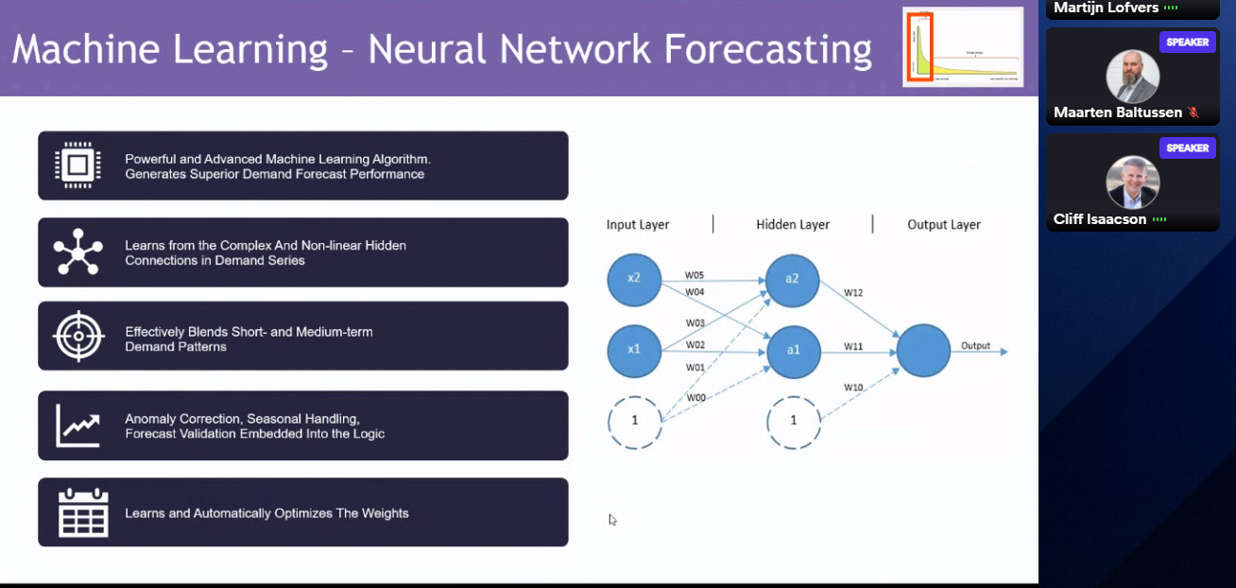

Slide 21
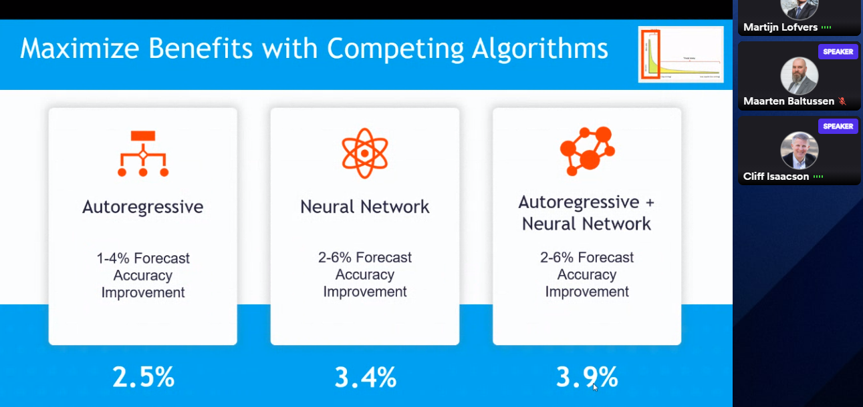

Slide 22
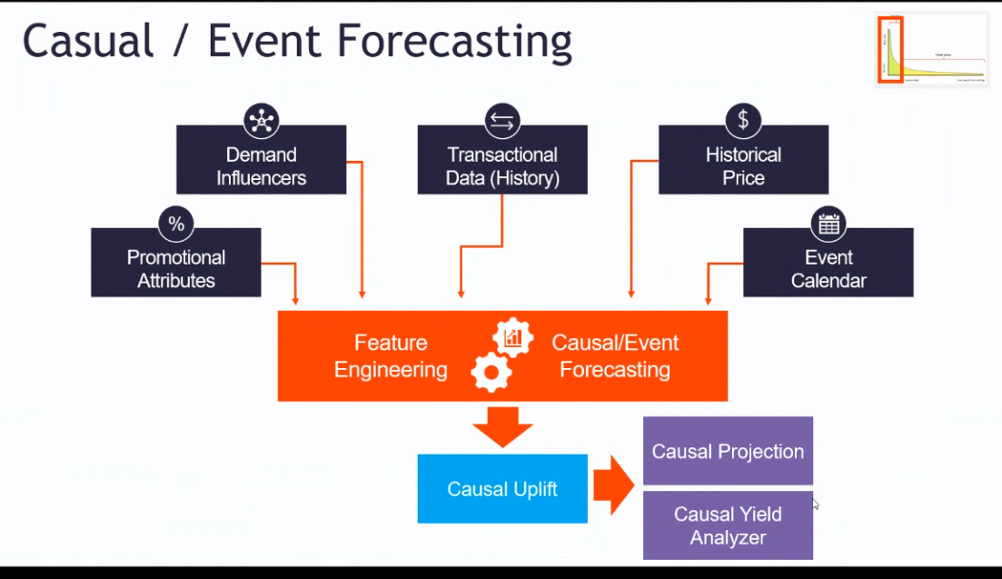
Demand shaping

Slide 23
